Slide 1
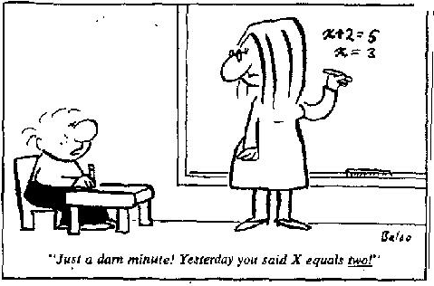
Section 2.2
Introduction to Algebra:
Using equations to model problems
© Copyright all rights reserved to Homework depot: www.BCMath.ca

Slide 2
I) What is Algebra?
A branch of mathematics that uses symbols and variables to represent a value in an equation
The symbol is often a letter “x”, “y”, or “c” depending on what it is representing
Ex: Write an equation for each of the following scenarios. Indicate what your variable represents?
i) All 30 students in a class have the same number of candies. Together, they have 2130 candies.
Variable: (S) number of candies each student has
ii) A 5 lb basket and 40 apples weigh 8lbs. Suppose all the apples weigh the same.
Variable: (a) weight of each apple

Slide 3
Practice: Write an equation for each of the following. Indicate what your variable represents:
i) The four tires and the 1500lb of a car weight 1900lbs.
ii) Bob has $20 more than Jason. Together, they have $190.
iii) The cost of 3 burgers and 12 hotdogs is $18.25

Slide 4
II) Balancing Equating with Scales:
When there is an “equal” sign, it indicates that both sides of the equation are equal
If we add values only to one side, the scale will tip and not equal
Rule: Whatever we do to isolate “x” on one side, we must do the same operation to the other side
To solve the equation we need to isolate “x” by
taking out the same values from both sides
Subtract 4 from both sides because there’s a plus 4 on the right
Divide both sides by 3
because “x” is multiplied by 3
So “X” is equal to 3.5

Slide 5
III) Basics with Solving Algebraic Equations:
To solve an equation,
1: perform the “opposite” operation that a variable is doing
2: What you do to one side, do the same to other side
Multiplication:
Division:
Addition
Subtraction
Divide both sides by 5
Multiply both sides by 3
Subtract 20 from both sides
Add 19 to both sides
The 5 divided by 5 is equal one
The 5’s cancel each other out
20 – 20 = zero!!!
The 3’s cancel out b/c 3 divided by 3 is equal to 1
– 19 + 19 = zero!!!

Slide 6
Multi-Steps
Reciprocals
Subtract 17 from both sides
Divide both sides by 3
Divide both sides by 3
Subtract 6 from both sides

Slide 7
Practice: Solve the following equations and show all your work and steps
(DO NOT Guess & Check)

Slide 9
IV) Solving Equations with Variables on Both sides:
When there are variables on both sides, find a way to move it all to one side by adding or subtracting the variables:
When the variables are only on one side, the equation is much easier to solve

Slide 10
When you have two or more terms with variables are on the same side, combined them first! (NOT Cancel!!)
Which terms on the left
can be combined together?
Which terms on the right
can be combined together?
The “2x” and “6x”
can be added
together
On the right side,
10 and -7 can be
subtracted from
each other
Now solve this
equation by moving
the “x’s” to one side
NOTE: When the “liketerms”
are on the same side,
“COMBINE” them.
BUT if they are on
opposite sides,
“CANCEL” them.

Slide 11
Practice: Solve the following equations

Slide 12
Practice: Solve the following equations

Slide 13
Practice: Solve the following equations

Slide 14
Practice: Use the balance to calculate the worth of one gold star
1
1
1
1
1
1
1
1
Q2: How much is one gold bar worth?
a)
b)
Q3: How much does one red square weigh?

Slide 15
Ex: How much does One star cost?
Ex: Record all your steps
1. Remove one star
from sides
1
1
1
1
1
2. Subtract two coins from sides
1
1
1
3. Divide each side
into two groups
4. Now there’s only one star on the left side and two coins on the right side
1
1
Therefore one star is equal to 2 coins

Slide 16
Practice: Solve the following equations for “x”
The goal of this question is to find out how much little boxes one yellow stick is equal to
Add “x” to
both sides
Add 2 to
both sides
Divide each
side into 4 groups
Subtract “x”
from both sides
Add 3
Divide each side
into 4 groups
Divide each
side by -1
Flip the colour on each side

Slide 17
How much does a single Red Square weigh?

Slide 18
Practice: Solve Each equation & Verify the solution:
Subtract 10
from both
sides
Add 4.5 to
both sides
Multiply
by-2
Multiply
by 3
Divide
by 3
Divide
by 4
There are 2 ways to do this question
Expand the
right side
Divide
by-2
Subtract 6
from both sides
Add 3 to
both sides
Divide both
sides by 2
Divide
by -1

